Slide 1
Web Application Development
CSS

Slide 2
What is CSS?
Remember: We use HTML to only describe structure and content of a page
<h1>This is heading contents</h1>
CSS (Cascading Style Sheets) allows us to apply formatting and styling to the HTML Elements/Tags.
CSS can control many elements of our web elements:
colors, fonts, alignment, borders, backgrounds, spacing, margins, and much more.
CSS is a style sheet language used to describe the presentation of a document.

Slide 3
CSS
What is CSS
CSS is a document that defines rules for layout of web application frontend.
It is designed primarily to enable the separation of document content (written in HTML or a similar markup language) from document presentation (written in CSS).
CSS can also allow the same markup page to be presented in different styles for different rendering methods, such as on-screen, in print, by voice
For example,
you can specify that the background of the page is cream, all paragraphs should appear in gray using the Arial typeface, or that all level one headings should be in a blue, italic, Times typeface.

Slide 4
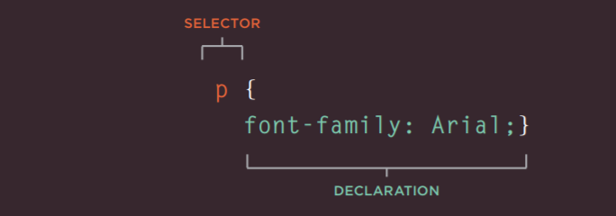
CSS
CSS Rule
A CSS rule contains two parts: a selector and a declaration.

Slide 5
CSS
CSS Rule
The previous rule indicates that all elements should be shown in the Arial typeface.
Selectors indicate which element (in this case p is an element) the rule applies to. The same rule can apply to more than one element if you separate the element names with commas.
Declarations indicate how the elements referred to in the selector should be styled

Slide 6
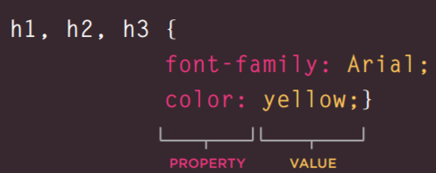
CSS
In a rule, there can be more than 1 element associated with declaration. Example h1, h2, h3 in following screen are associated with declaration.
This rule indicates that all , <h1>, <h2>, and <h3> elements should be shown in the Arial typeface, and in a yellow color.
Declaration

Slide 7
CSS
Properties indicate the aspects of the element you want to change. For example, color, font, width, height and border.
Values specify the settings you want to use for the chosen properties. For example, if you want to specify a color property then the value is the color you want the text in these elements to be.

Slide 8
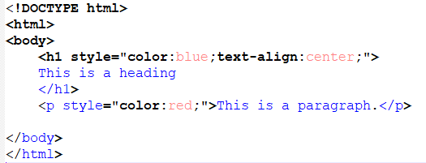
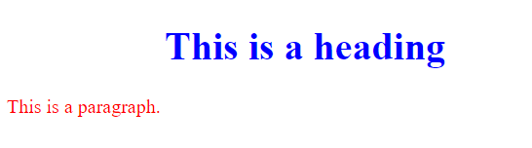
CSS Example
Example CSS
Output

Slide 9
CSS
How to bind CSS with HTML document>
Inline
styles are placed right where you need them, next to the text you wish to decorate.
Internal – Embedded Stylesheets
styles are placed at the top of each web page document, before any of the content is listed.
On-page <head> style definitions
External
External style sheets are separate files full of CSS instructions. You need to refer this file in your html document.
Example
<link href="example.css" type="text/css“ rel="stylesheet" />

Slide 10
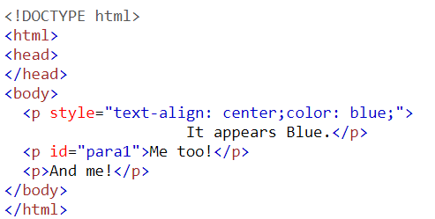
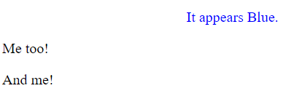
CSS
Example Inline CSS
output

Slide 11
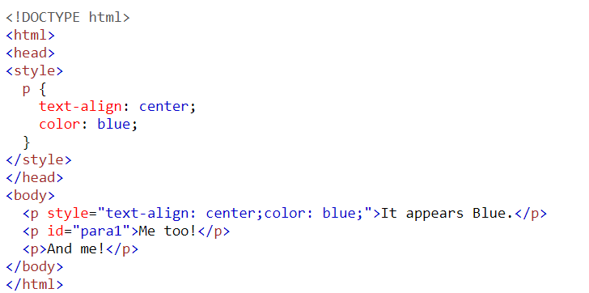
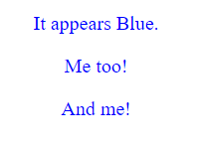
CSS
Example Internal CSS
styles are placed at the top of each web page document, before any of the content is listed.

Slide 12
On-Page Style Definitions
The benefit of this over the previous approach (in line) is that the style definitions are only written once.
Use this method when you want to apply similar styles to multiple elements on a page, but not on any other pages.
Embedded style sheets are not scale able to multiple pages.
To apply the same styles to things on multiple pages, you need to use the next method (Separate style sheets).

Slide 13
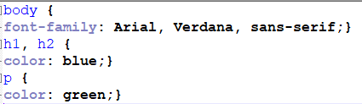
CSS
Example external CSS
External style sheets are separate files full of CSS instructions. You need to refer this file in your html document.
Create a file called ExtCSS.css and past following
Create html document and refer ExtCSS.css into it
See next slide

Slide 14
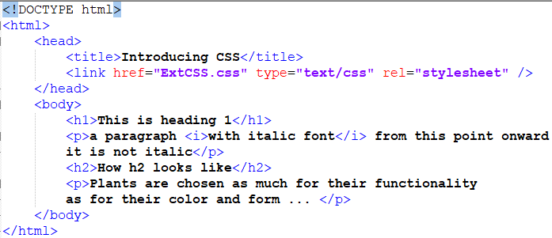
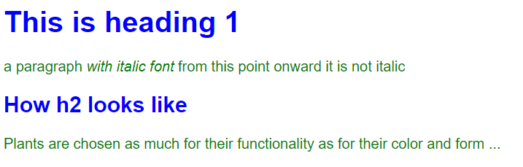
CSS
HTML document with External CSS
Self closing tag

Slide 15
CSS
Referring external CSS file
<link>
element can be used in an HTML document to tell the browser where to find the CSS file used to style the page. It is an empty element (meaning it does not need a closing tag), and it lives inside the <head> element. It should use three attributes:
href
This specifies the path to the CSS file (which is often placed in a folder called css or styles).
type
This attribute specifies the type of document being linked to. The value should be text/css.
rel
This specifies the relationship between the HTML page and the file it is linked to. The value should be stylesheet when linking to a CSS file.

Slide 16
Separate Style Sheets
Advantages of separate style sheets
Reduced file size - each CSS definition is written only once
Reduced bandwidth - web browsers will remember (cache) the contents of CSS file
Easier updating - you only have to change styles in one place for them to change site-wide
Separates the work of styling and creating content - you can create all your HTML pages first, applying sensible semantic markup, class names and IDs, and then do all your design work later on your style sheets.

Slide 17
CSS
In CSS one can select elements for styling purposes based on
Type
ID
Class
Attribute

Slide 18
CSS
CSS selectors can be divided into different categories
Simple selectors
Grouping Selector
Universal Selector
Combinator selectors / Relational Selector
Pseudo-class selectors
Pseudo-elements selectors
Attribute selectors

Slide 19
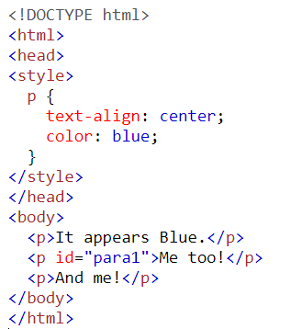
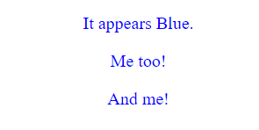
CSS
Simple selectors (select elements based on name, id, class)
In following, element is selected based on name

Slide 20
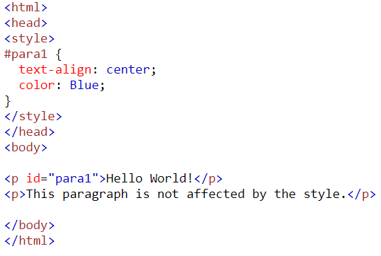
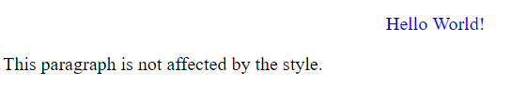
CSS
Simple selectors (select elements based on name, id, class)
In following, element is selected based on Id

Slide 21
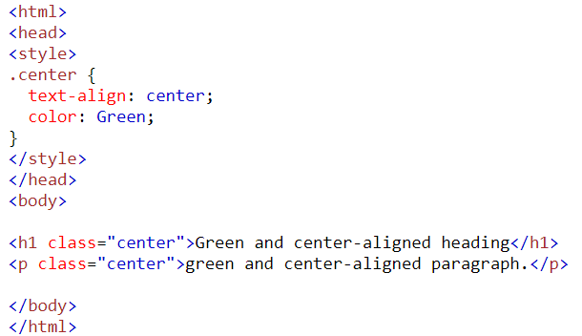
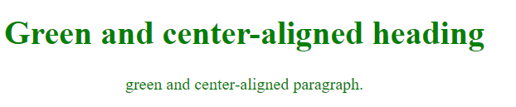
CSS
Simple selectors (select elements based on name, id, class)
In following, element is selected based on class

Slide 22
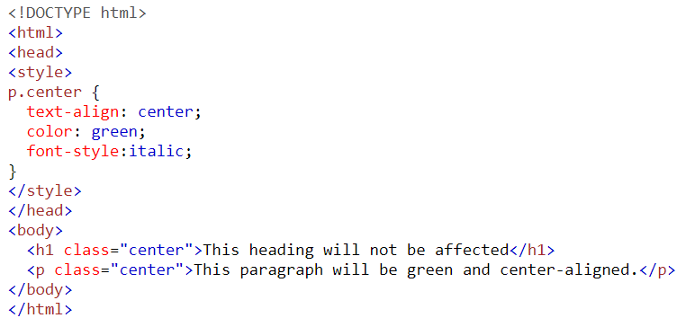
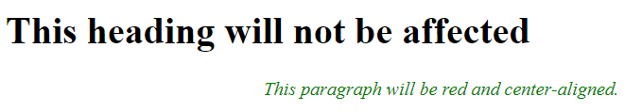
CSS
Simple selectors (select elements based on name, id, class)
In following, element is selected based on specific class

Slide 23
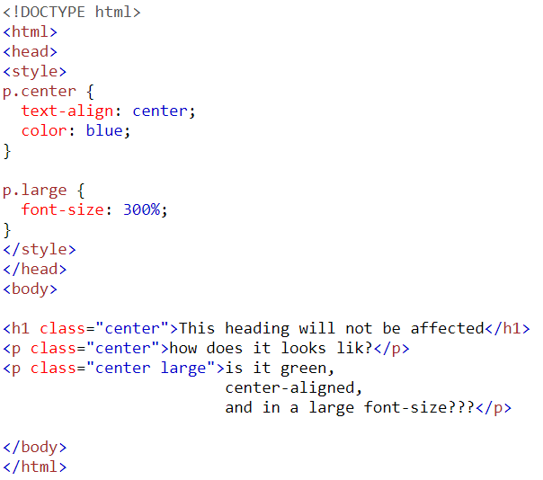
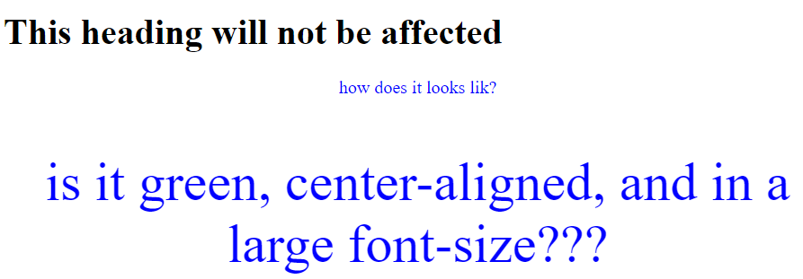
CSS
Simple selectors (select elements based on name, id, class)

Slide 24
CSS
Difference between ID and CLASS
Can not have multiple elements with same id but can have multiple elements with same class.
ID MUST BE UNIQUE

Slide 25
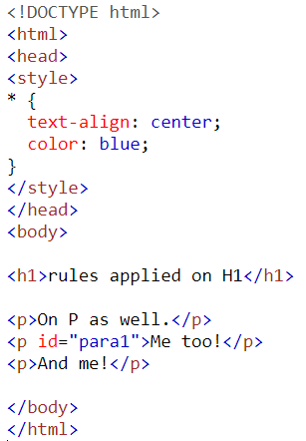
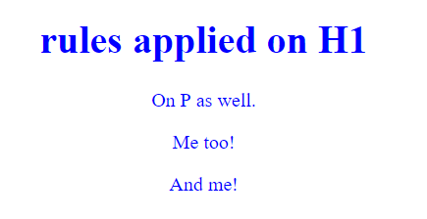
CSS
Universal selector
The universal selector (*) selects all HTML elements on the page.

Slide 26
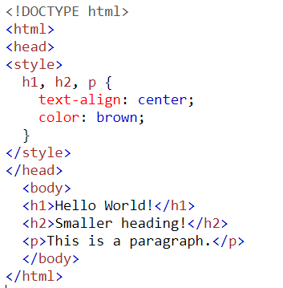
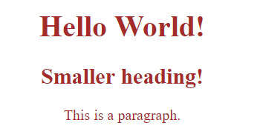
CSS
Grouping Selector
The grouping selector selects all the HTML elements with the same style definitions.

Slide 27
CSS
Combinators selector
Also known as relational selectors
select elements based on a specific relationship between them
Example
descendant selector (space)
child selector (>)
adjacent sibling selector (+)
general sibling selector (~)

Slide 28
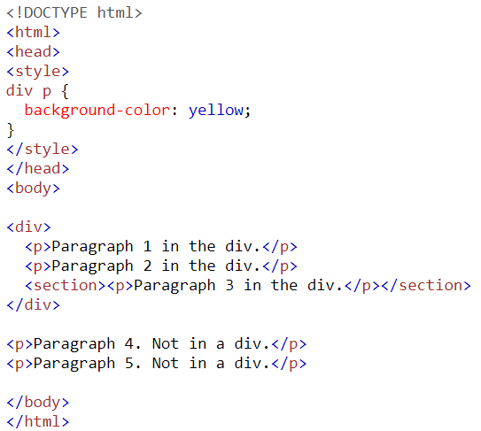
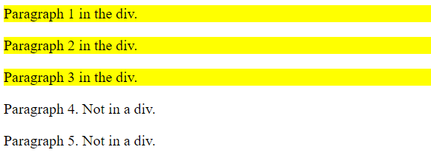
CSS
Combinator
Descendent selector
The descendant selector matches all elements that are descendants of a specified element.

Slide 29
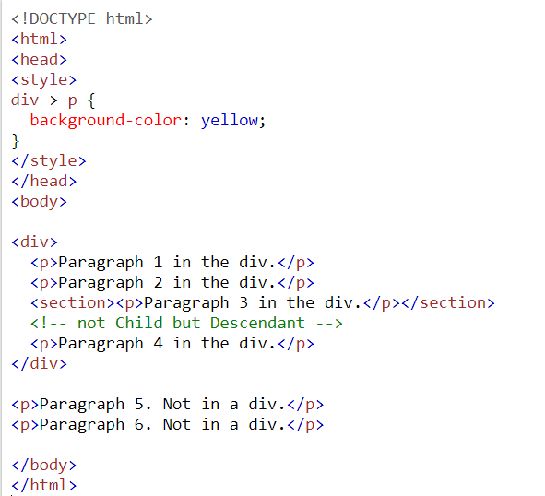
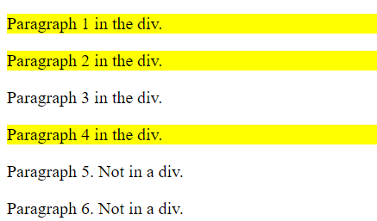
CSS
Combinator
Child selector
The child selector selects all elements that are the children of a specified element.

Slide 30
CSS
Combinator
Adjacent Sibling Selector
The adjacent sibling selector selects all elements that are the adjacent siblings of a specified element.
Sibling elements must have the same parent element, and "adjacent" means "immediately following".

Slide 31
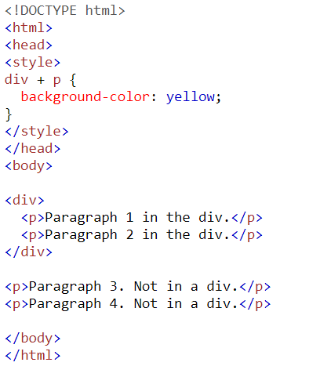
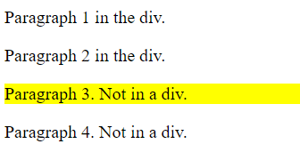
CSS
Combinator
Adjacent Sibling Selector.

Slide 32
CSS
Combinator
General Sibling Selector
The general sibling selector selects all elements that are siblings of a specified element and comes after the specified selectors.

Slide 33
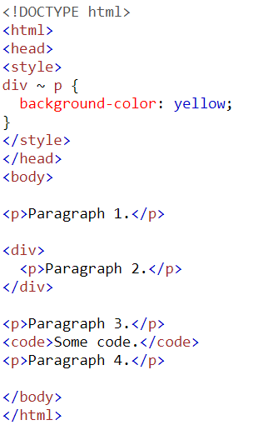
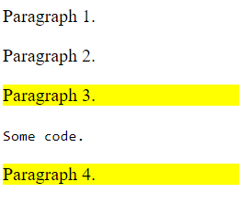
CSS
Combinator
General Sibling OR following sibling

Slide 34
CSS
Combinator or Relational Selectors
Cleaner markup without ids and classes
Can be temporary (moving elements will change the styling)

Slide 35
CSS
Summary of Combinator selector
Selector | Example | Example description
element element | div p | Selects all <p> elements inside <div> elements
element>element | div > p | Selects all <p> elements where the parent is a <div> element
element+element | div + p | Selects all <p> elements that are placed immediately after <div> elements
element1~element2 | p ~ ul | Selects every <ul> element that are preceded by a <p> element

Slide 36
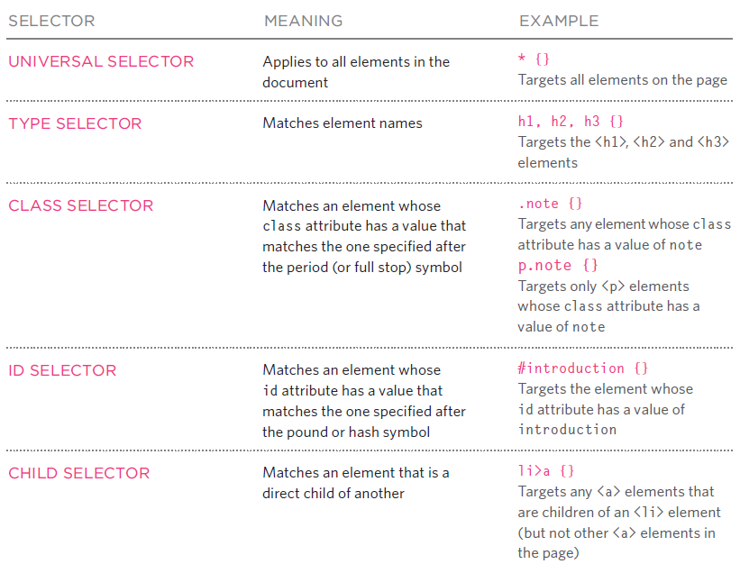
Summary: CSS selectors

Slide 37
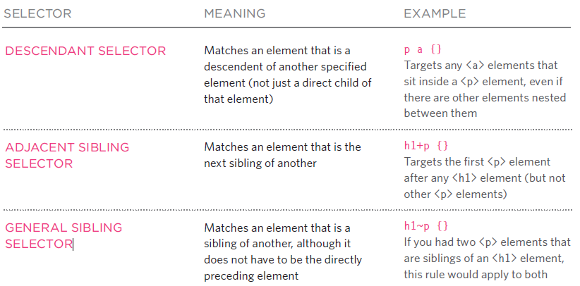
Summary: CSS selectors

Slide 38
CSS
Pseudo-class selectors
Select elements based on a certain state
A pseudo-class is used to define a special state of an element.
Pseudo-class are not actual classes, they are predefined classes applied by browsers on elements
For example, it can be used to:
Style an element when a mouse hover over it
Style visited and unvisited links differently
Style an element when it gets focus
Syntax
selector : pseudo-class { property:value; }

Slide 39
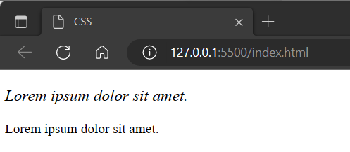
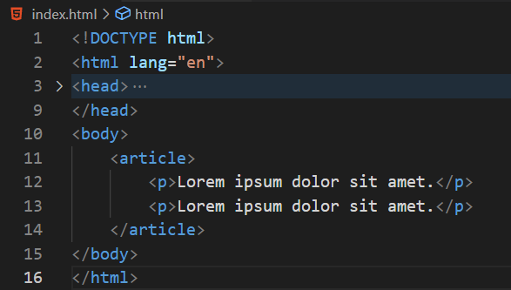
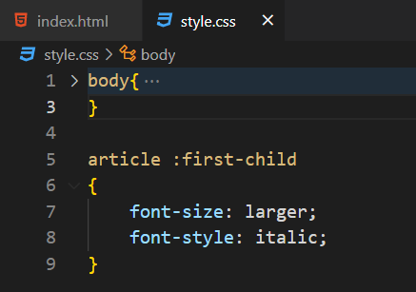
CSS
Pseudo-class selectors
All pseudo classes start with colon :
Mention the class name after colon called as Pseudo class Selector

Slide 40
CSS
Pseudo-class selectors Examples
Anchor Pseudo-classes
a:link
Describes properties associated with hyperlink
a:visited
Color of hyperlink once it is visited
a:hover
Color of hyperlink once user hovers over it
a:active
Color of hyperlink once clicked

Slide 41
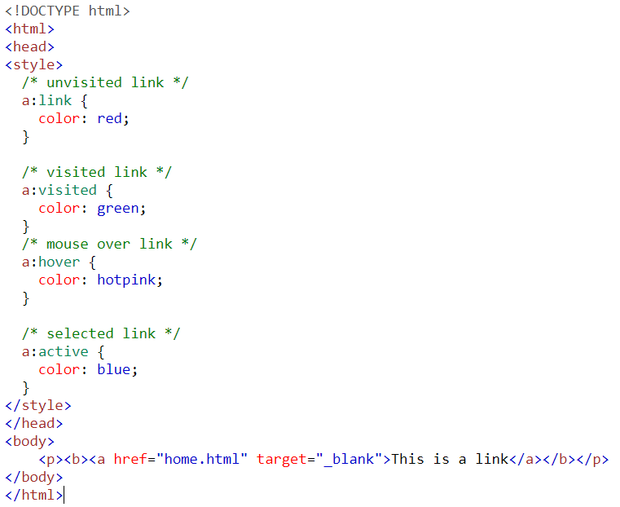
CSS
Example

Slide 42
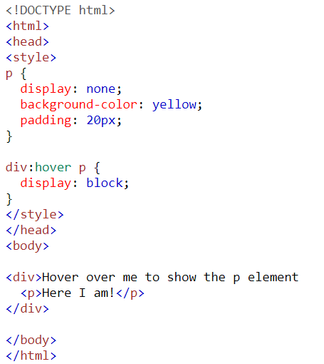
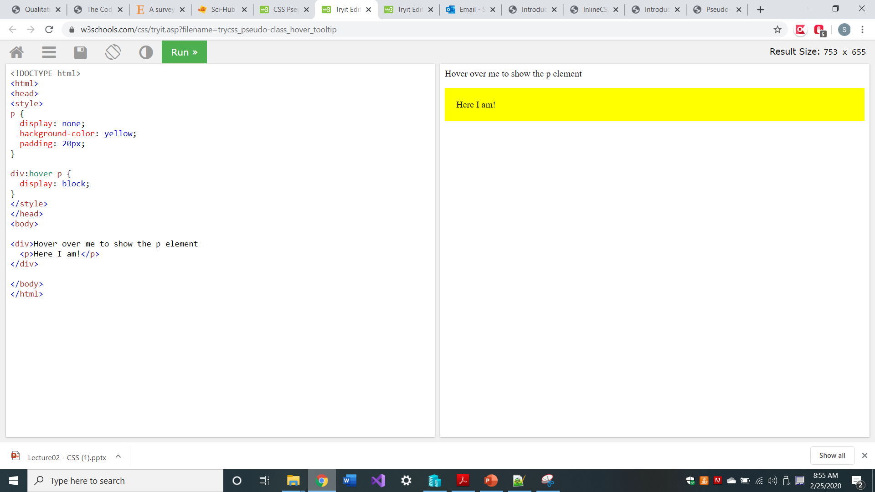
CSS
Pseudo-class
Example (Tooltip Hover)

Slide 43
CSS
Pseudo-element selectors
Used for styling a small part of an element only
Pseudo-element selectors are used to style a certain part of element
To style part of an element e.g., first letter
Double colons are used for Pseudo-elements
Syntax
selector :: pseudo-element { property:value; }

Slide 44
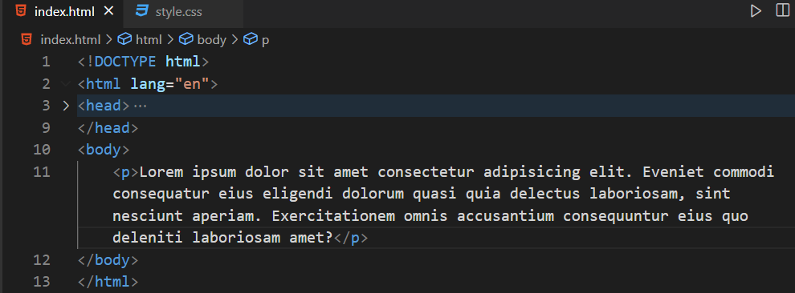
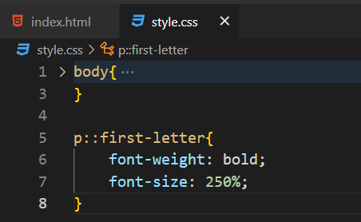
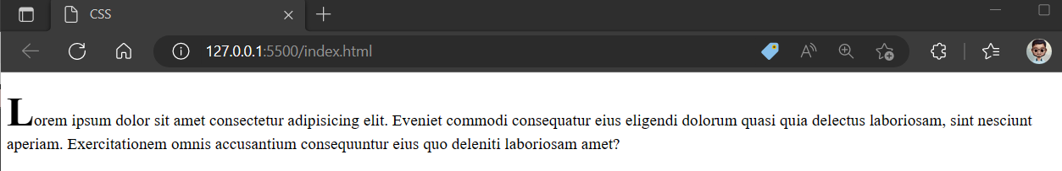
Pseudo-Element Selector

Slide 45
Rules for Applying CSS
If there are two or more rules that apply to the same element, it is important to understand which will take precedence.

Slide 46
CSS Priority Rule
CSS Properties applies in following order
Inline properties has highest priority.
On page style has less priority then inline, and more priority then external CSS.
External CSS has least priority.
1
Inline CSS
2
On page CSS
3
External CSS

Slide 47
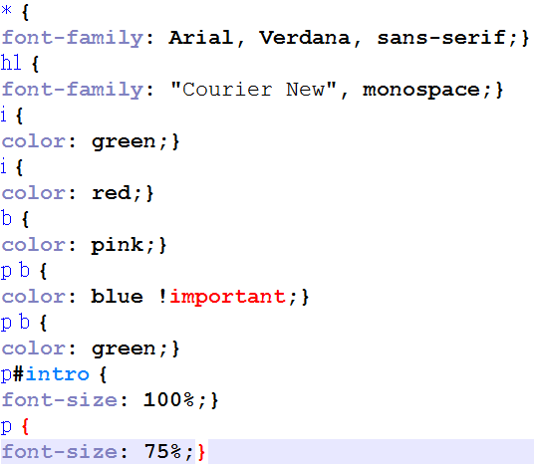
If there are two or more rules that apply to the same element, it is important to understand which will take precedence.
LAST RULE
If the two selectors are identical, the latter of the two will take precedence. Here you can see the second i selector takes precedence over the first.

Slide 48
SPECIFICITY
If one selector is more specific than the others, the more specific rule will take precedence over more general ones. In this
example:
h1 is more specific than *
p b is more specific than p
p#intro is more specific than p

Slide 49
IMPORTANT
You can add !important after
any property value to indicate
that it should be considered
more important than other rules that apply to the same element.

Slide 50
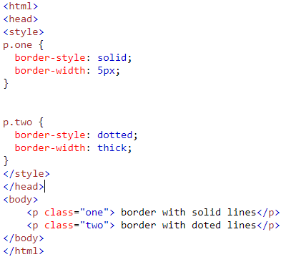
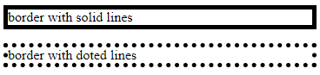
Borders

Slide 51
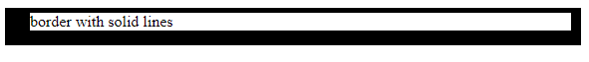
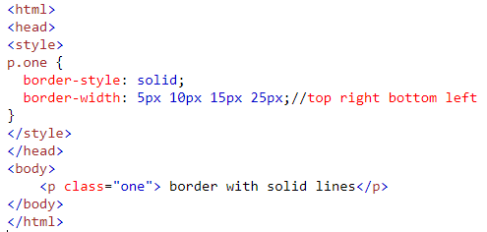
Borders

Slide 52
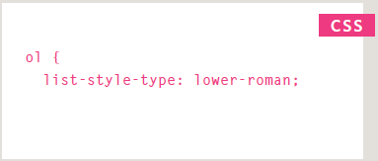


List: Example

Slide 53


Page Padding
Example

Slide 54


Page Padding
Page Padding

Slide 55


CSS
Example

Slide 56


CSS

Slide 57
List Property
The list-style-type property allows you to control the shape or style of a bullet point (also known as a marker).
Unordered Lists
For an unordered list you can use the following values:
none
disc
circle
square

Slide 58
List Property
Ordered List
For an ordered (numbered) list you can use the following values:
decimal
1 2 3
decimal-leading-zero
01 02 03
lower-alpha
a b c
upper-alpha
A B C
lower-roman
i. ii. iii.
upper-roman
I II III

Slide 59



Slide 60

Home Task

Slide 61

Home Task

Slide 62

Home Task
Output

Slide 63

LAYOUT ELEMENTS
Websites often display content in multiple columns
<header> Defines a header for a document or a section
<nav> Defines a container for navigation links
<section> Defines a section in a document
<article> Defines an independent self-contained article
<aside> Defines content aside from the content (like a sidebar)
<footer> Defines a footer for a document or a section
<details> Defines additional details
<summary> Defines a heading for the <details> element

Slide 64


Page Layout

Slide 65

Output

Slide 66

WEBSITE LAYOUT

Slide 67

WEBSITE LAYOUT

Slide 68

WEBSITE LAYOUT

Slide 69



CONTENT
1-column (often used for mobile browsers)
2-column (often used for tablets and laptops)
3-column layout (only used for desktops)

Slide 70



WEBSITE LAYOUT

Slide 71



WEBSITE LAYOUT

Slide 72

WEBSITE LAYOUT

Slide 73


WEBSITE LAYOUT

Slide 74

WEBSITE LAYOUT

Slide 75

WEBSITE LAYOUT

Slide 76



IMAGES

Slide 77



IMAGES

Slide 78



IMAGES

Slide 79





IMAGES

Slide 80


IMAGES

Slide 81
COLORS
The color property to specify the color of text inside an element
Computer monitors are made up of thousands of tiny squares called pixels
Every color is created by mixing amounts of RED, GREEN, and BLUE
RGB VALUES | HEX CODES | COLOR NAMES
Values for red, green, and blue are expressed as numbers between 0 and 255. | Hex values represent values for red, green, and blue in hexadecimal code. | Colors are represented by predefined names. However, they are very limited in number.
rgb(102,205,170) | #66cdaa | MediumAquaMarine
102 red 205 green 170 blue | value of the red, 102, is expressed as 66 205 of the green is expressed as cd the 170 of blue equates to aa. | There are 147 color names supported by browsers

Slide 82



COLORS
HUE | SATURATION | BRIGHTNESS
Hue is near to the colloquial idea of color. | Saturation refers to the amount of gray in a color. At maximum saturation, there would be no gray in the color. At minimum saturation, the color would be mostly gray. | Brightness (or "value") refers to how much black is in a color. At maximum brightness, there would be no black in the color. At minimum brightness, the color would be very dark.

Slide 83




COLORS

Slide 84




COLORS

Slide 85

HTML CSS – Visual Studio

Slide 86

HTML CSS – Visual Studio

Slide 87

HTML CSS – Visual Studio

Slide 88

HTML CSS – Visual Studio

Slide 89

HTML Page – Visual Studio

Slide 90

HTML CSS – Visual Studio

Slide 91

HTML CSS – Visual Studio

Slide 92

HTML CSS – Visual Studio

Slide 93

HTML CSS – Visual Studio

Slide 94

HTML CSS – Visual Studio

Slide 95


HTML Page – Visual Studio

